Slide 1
Python - NumPy
What is a Python NumPy?
NumPy is a Python package which stands for ‘Numerical Python’.
It is the core library for scientific computing, which contains a powerful n-dimensional array object, provide tools for integrating C, C++ etc.
It is also useful in linear algebra, random number capability etc.
NumPy array can also be used as an efficient multi-dimensional container for generic data.
Now, let me tell you what exactly is a python numpy array.

Slide 2
Python - NumPy
NumPy Array: Numpy array is a powerful N-dimensional array object which is in the form of rows and columns. We can initialize numpy arrays from nested Python lists and access it elements. In order to perform these numpy operations, the next question which will come in your mind is:
How do I install NumPy?
To install Python NumPy, go to your command prompt and type “pip install numpy”.
Once the installation is completed, go to your IDE (For example: PyCharm) and simply import it by typing: “import numpy as np”

Slide 3
Python - NumPy
What exactly is a multi-dimensional numPy array.
Here, I have different elements that are stored in their respective memory locations. It is said to be two dimensional because it has rows as well as columns. In the above image, we have 3 columns and 4 rows available.

Slide 4
Python - NumPy
Let us see how it is implemented
Single-dimensional Numpy Array:
import numpy as np
a=np.array([1,2,3])
print(a)
Output – [1 2 3]
Multi-dimensional Array:
a=np.array([(1,2,3),(4,5,6)])
print(a)
O/P – [[ 1 2 3]
[4 5 6]]
Notes:
Many of you must be wondering that why do we use python numpy if we already have python list? So, let us understand with some examples in this python numpy tutorial.

Slide 5
Python – NumPy Array vs List
We use python numpy array instead of a list because of the below three reasons:
Less Memory
Fast
Convenient
The very first reason to choose python numpy array is that it occupies less memory as compared to list.
Then, it is pretty fast in terms of execution and at the same time it is very convenient to work with numpy. So these are the major advantages that python numpy array has over list.
Don’t worry, I am going to prove the above points one by one practically.

Slide 6
Python – NumPy Array vs List
Consider the below example:
import numpy as np
import time
import sys
S= range(1000)
print(sys.getsizeof(5)*len(S))
D= np.arange(1000)
print(D.size*D.itemsize)
O/P – 14000
4000
Notes:
The above output shows that the memory allocated by list (denoted by S) is 14000 whereas the memory allocated by the numpy array is just 4000. From this, you can conclude that there is a major difference between the two and this makes python numpy array as the preferred choice over list.
Here you can think of S= []

Slide 7
Python – NumPy Array vs List
Consider the below example:
import numpy as np
import time
import sys
S= range(1000)
print(sys.getsizeof(5)*len(S))
D= np.arange(1000)
print(D.size*D.itemsize)
O/P – 14000
4000
Notes:
The above output shows that the memory allocated by list (denoted by S) is 14000 whereas the memory allocated by the numpy array is just 4000. From this, you can conclude that there is a major difference between the two and this makes python numpy array as the preferred choice over list.
Here you can think of S= []

Slide 8
Python – NumPy Array vs List
Consider the below example:
Next, let’s talk how python numpy array is faster and more convenient when compared to list.
import time
import sys
SIZE = 1000000
L1= range(SIZE)
L2= range(SIZE)
A1= np.arange(SIZE)
A2=np.arange(SIZE)
start= time.time()
result=[(x,y) for x,y in zip(L1,L2)]
print((time.time()-start)*1000)
start=time.time()
result= A1+A2
print((time.time()-start)*1000)
Notes:
In the above code, we have defined two lists and two numpy arrays. Then, we have compared the time taken in order to find the sum of lists and sum of numpy arrays both. If you see the output of the above program, there is a significant change in the two values. List took 380ms whereas the numpy array took almost 49ms. Hence, numpy array is faster than list. Now, if you noticed we had run a ‘for’ loop for a list which returns the concatenation of both the lists whereas for numpy arrays, we have just added the two array by simply printing A1+A2. That’s why working with numpy is much easier and convenient when compared to the lists.
Therefore, the above examples proves the point as to why you should go for python numpy array rather than a list!

Slide 9
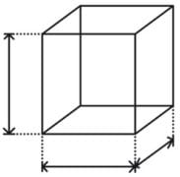
Python NumPy Operations
ndim:
You can find the dimension of the array, whether it is a two-dimensional array or a single dimensional array.
So, let us see this practically how we can find the dimensions.
In the below code, with the help of ‘ndim’ function, I can find whether the array is of single dimension or multi dimension.
import numpy as np
a = np.array([(1,2,3),(4,5,6)])
print(a.ndim)
Output – 2
Since the output is 2, it is a two-dimensional array (multi dimension).

Slide 10

Python NumPy Operations
itemsize:
You can calculate the byte size of each element. In the below code, I have defined a single dimensional array and with the help of ‘itemsize’ function, we can find the size of each element.
import numpy as np
a = np.array([(1,2,3)])
print(a.itemsize)
Output – 4
So every element occupies 4 byte in the above numpy array.

Slide 11

Python NumPy Operations
dtype:
You can find the data type of the elements that are stored in an array. So, if you want to know the data type of a particular element, you can use ‘dtype’ function which will print the datatype along with the size.
In the below code, I have defined an array where I have used the same function.
import numpy as np
a = np.array([(1,2,3)])
print(a.dtype)
Output – int32

Slide 12
Python NumPy Operations
dtype:
As you can see, the data type of the array is integer 32 bits. Similarly, you can find the size and shape of the array using ‘size’ and ‘shape’ function respectively.
import numpy as np
a = np.array([(1,2,3,4,5,6)])
print(a.size)
print(a.shape)
Output – 6 (1,6)
Next, let us move forward and see what are the other operations that you can perform with python numpy module.
We can also perform reshape as well as slicing operation using python numpy operation.
But, what exactly is reshape and slicing? So let me explain this one by one here.

Slide 13
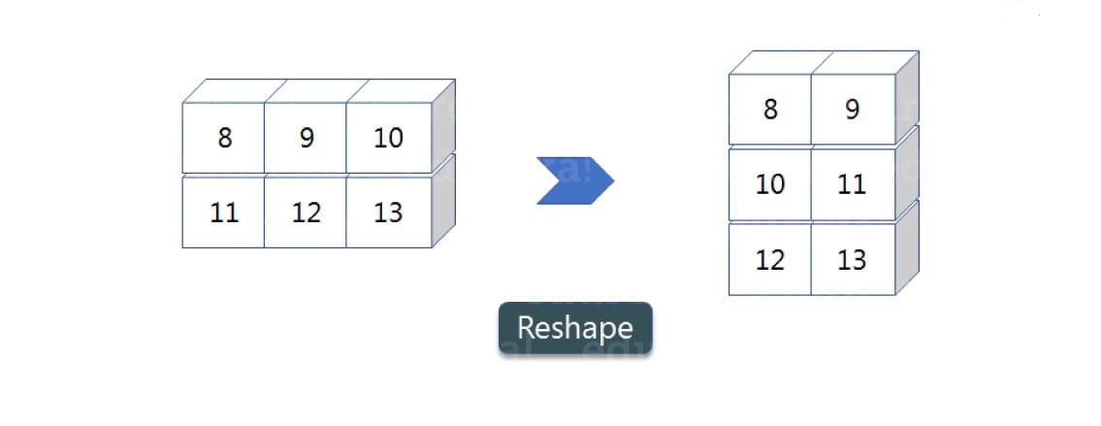
Python NumPy Operations
reshape:
Reshape is when you change the number of rows and columns which gives a new view to an object.
Now, let us take an example to reshape the below array:
As you can see in the above image, we have 3 columns and 2 rows which has converted into 2 columns and 3 rows. Let me show you practically how it’s done.

Slide 14
Python NumPy Operations
reshape: …contd.
import numpy as np
a = np.array([(8,9,10),(11,12,13)])
print(a)
a=a.reshape(3,2)
print(a)
Output – [[ 8 9 10] [11 12 13]] [[ 8 9] [10 11] [12 13]]

Slide 15
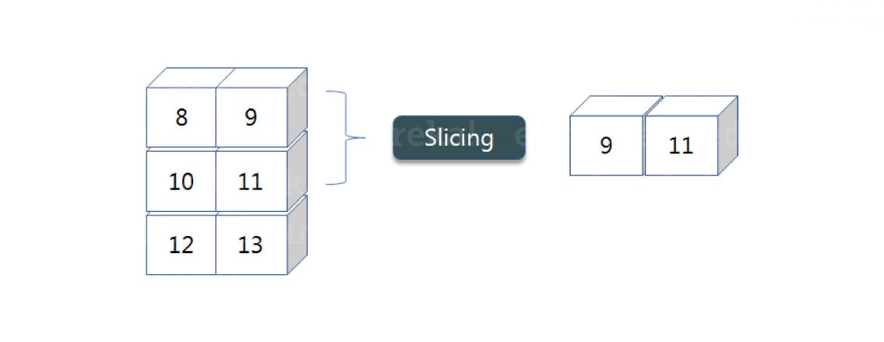
Python NumPy Operations
slicing:
As you can see the ‘reshape’ function has showed its magic.
Now, let’s take another operation i.e Slicing. Slicing is basically extracting particular set of elements from an array.
This slicing operation is pretty much similar to the one which is there in the list as well.
Consider the following example:

Slide 16
Python NumPy Operations
slicing: …contd.
Before getting into the previous example, let’s see a simple one.
We have an array and we need a particular element (say 3) out of a given array. Let’s consider the below example:
import numpy as np
a=np.array([(1,2,3,4),(3,4,5,6)])
print(a[0,2])
Output – 3
Here, the array(1,2,3,4) is your index 0 and (3,4,5,6) is index 1 of the python numpy array.
Therefore, we have printed the second element from the zeroth index.
Taking one step forward, let’s say we need the 2nd element from the zeroth and first index of the array. Let’s see how you can perform this operation:
import numpy as np
a=np.array([(1,2,3,4),(3,4,5,6)])
print(a[0:,2])
Output – [3 5]

Slide 17
Python NumPy Operations
slicing: …contd.
Here colon represents all the rows, including zero. Now to get the 2nd element, we’ll call index 2 from both of the rows which gives us the value 3 and 5 respectively.
Next, just to remove the confusion, let’s say we have one more row and we don’t want to get its 2nd element printed just as the image above. What we can do in such case?
Consider the below code:
import numpy as np
a=np.array([(8,9),(10,11),(12,13)])
print(a[0:2,1])
Output – [9 11]
As you can see in the above code, only 9 and 11 gets printed. Now when I have written 0:2, this does not include the second index of the third row of an array. Therefore, only 9 and 11 gets printed else you will get all the elements i.e [9 11 13].

Slide 18
Python NumPy Operations
linspace
This is another operation in python numpy which returns evenly spaced numbers over a specified interval. Consider the below example:
import numpy as np
a=np.linspace(1,3,10)
print(a)
Output – [ 1. 1.22222222 1.44444444 1.66666667 1.88888889 2.11111111 2.33333333 2.55555556 2.77777778 3. ]
As you can see in the result, it has printed 10 values between 1 to 3.

Slide 19
Python NumPy Operations
max/ min
Next, we have some more operations in numpy such as to find the minimum, maximum as well the sum of the numpy array. Let’s go ahead in python numpy tutorial and execute it practically.
import numpy as np
a= np.array([1,2,3])
print(a.min())
print(a.max())
print(a.sum())
Output – 1 3 6
You must be finding these pretty basic, but with the help of this knowledge you can perform a lot bigger tasks as well.
Now, lets understand the concept of axis in python numpy.

Slide 20
Python NumPy Operations
max/ min
Next, we have some more operations in numpy such as to find the minimum, maximum as well the sum of the numpy array. Let’s go ahead in python numpy tutorial and execute it practically.
import numpy as np
a= np.array([1,2,3])
print(a.min())
print(a.max())
print(a.sum())
Output – 1 3 6
You must be finding these pretty basic, but with the help of this knowledge you can perform a lot bigger tasks as well.
Now, lets understand the concept of axis in python numpy.

Slide 21
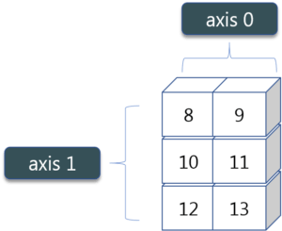
Python NumPy Operations
max/ min …contd.
Now, lets understand the concept of axis in python numpy.
As you can see in the figure, we have a numpy array 2*3.
Here the rows are called as axis 1 and the columns are called as axis 0.
Now you must be wondering what is the use of these axis?
Suppose you want to calculate the sum of all the columns, then you can make use of axis.
Let me show you practically, how you can implement axis in your IDE:
a= np.array([(1,2,3),(3,4,5)])
print(a.sum(axis=0))
Output – [4 6 8]
Therefore, the sum of all the columns are added where 1+3=4, 2+4=6 and 3+5=8.
Similarly, if you replace the axis by 1, then it will print [6 12] where all the rows get added.

Slide 22
Python NumPy Operations
Square Root & Standard Deviation
There are various mathematical functions that can be performed using python numpy. You can find the square root, standard deviation of the array. So, let’s implement these operations:
import numpy as np
a=np.array([(1,2,3),(3,4,5,)])
print(np.sqrt(a))
print(np.std(a))
Output – [[ 1. 1.41421356 1.73205081]
[ 1.73205081 2. 2.23606798]]
1.29099444874
As you can see the output above, the square root of all the elements are printed. Also, the standard deviation is printed for the above array i.e how much each element varies from the mean value of the python numpy array.

Slide 23
Python NumPy Operations
Addition Operation
You can perform more operations on numpy array i.e addition, subtraction,multiplication and division of the two matrices. Let me go ahead in python numpy tutorial, and show it to you practically:
import numpy as np
x= np.array([(1,2,3),(3,4,5)])
y= np.array([(1,2,3),(3,4,5)])
print(x+y)
Output – [[ 2 4 6] [ 6 8 10]]
This is extremely simple! Right? Similarly, we can perform other operations such as subtraction, multiplication and division. Consider the below example:
import numpy as np
x= np.array([(1,2,3),(3,4,5)])
y= np.array([(1,2,3),(3,4,5)])
print(x-y)
print(x*y)
print(x/y)
Output – [[0 0 0] [0 0 0]]
[[ 1 4 9] [ 9 16 25]]
[[ 1. 1. 1.] [ 1. 1. 1.]]

Slide 24
Python NumPy Operations
Addition Operation
You can perform more operations on numpy array i.e addition, subtraction,multiplication and division of the two matrices. Let me go ahead in python numpy tutorial, and show it to you practically:
import numpy as np
x= np.array([(1,2,3),(3,4,5)])
y= np.array([(1,2,3),(3,4,5)])
print(x+y)
Output – [[ 2 4 6] [ 6 8 10]]
This is extremely simple! Right? Similarly, we can perform other operations such as subtraction, multiplication and division. Consider the below example:
import numpy as np
x= np.array([(1,2,3),(3,4,5)])
y= np.array([(1,2,3),(3,4,5)])
print(x-y)
print(x*y)
print(x/y)
Output – [[0 0 0] [0 0 0]]
[[ 1 4 9] [ 9 16 25]]
[[ 1. 1. 1.] [ 1. 1. 1.]]

Slide 25
Python NumPy Operations
Vertical & Horizontal Stacking
Next, if you want to concatenate two arrays and not just add them, you can perform it using two ways – vertical stacking and horizontal stacking. Let me show it one by one in this python numpy tutorial.
import numpy as np
x= np.array([(1,2,3),(3,4,5)])
y= np.array([(1,2,3),(3,4,5)])
print(np.vstack((x,y)))
print(np.hstack((x,y)))
Output – [[1 2 3] [3 4 5] [1 2 3] [3 4 5]]
[[1 2 3 1 2 3] [3 4 5 3 4 5]]
ravel
There is one more operation where you can convert one numpy array into a single column i.e ravel. Let me show how it is implemented practically:
import numpy as np
x= np.array([(1,2,3),(3,4,5)])
print(x.ravel())
Output – [ 1 2 3 3 4 5]

Slide 26
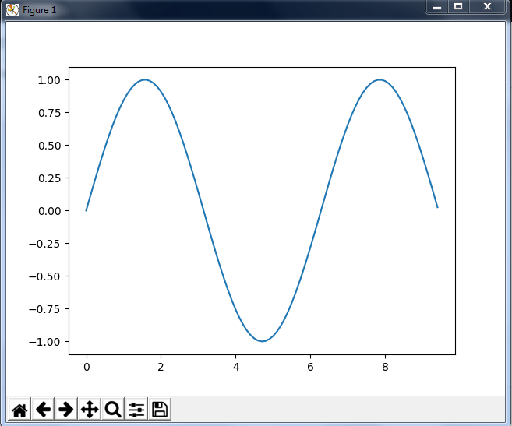
Python NumPy Operations -Special Functions
There are various special functions available in numpy such as sine, cosine, tan, log etc.
First, let’s begin with sine function where we will learn to plot its graph. For that, we need to import a module called matplotlib. Refer matplotlib ppts.
Lets see how these graphs are plotted:
import numpy as np
import matplotlib.pyplot as plt
x= np.arange(0,3*np.pi,0.1)
y=np.sin(x)
plt.plot(x,y)
plt.show()
Similarly, you can plot a graph for any trigonometric function such as cos, tan etc.
Let me show you one more example where you can plot a graph of another function, let’s say tan.

Slide 27
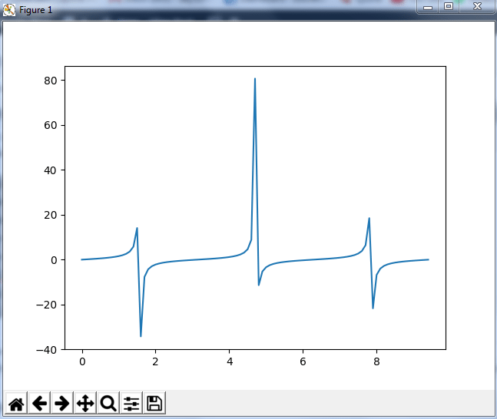
Python NumPy Operations -Special Functions
Plot tan
Let me show you one more example where you can plot a graph of another function, let’s say tan.
import numpy as np
import matplotlib.pyplot as plt
x= np.arange(0,3*np.pi,0.1)
y=np.tan(x)
plt.plot(x,y)
plt.show()

Slide 28
Python NumPy Operations -Special Functions
Other special functionality in numpy array such as exponential and logarithmic function
Now in exponential, the e value is somewhere equal to 2.7 and in log, it is actually log base 10.
When we talk about natural log i.e log base e, it is referred as Ln or log base n.
So let’s see how it is implemented practically:
a= np.array([1,2,3])
print(np.exp(a))
Output – [ 2.71828183 7.3890561 20.08553692]
As you can see the above output, the exponential values are printed i.e e raise to the power 1 is e, which gives the result as 2.718…
Similarly, e raise to the power of 2 gives the value somewhere near 7.38 and so on.

Slide 29
Python NumPy Operations -Special Functions
Logarithmic function
Next, in order to calculate log, let’s see how you can implement it:
import numpy as np
import matplotlib.pyplot as plt
a= np.array([1,2,3])
print(np.log(a))
Output – [ 0. 0.69314718 1.09861229]
Here, we have calculated natural log which gives the value as displayed above.
Now, if we want log base 10 instead of Ln or natural log, you can follow the below code:
import numpy as np
import matplotlib.pyplot as plt
a= np.array([1,2,3])
print(np.log10(a))
Output – [ 0. 0.30103 0.47712125]

Slide 30
Python NumPy- Reference
Further Reading
https://numpy.org/devdocs/user/quickstart.html

